Slide 1
OBJECTS AS A MEANS OF ABSTRACTION
@EINARWH
Notes:
Hi everyone, my name is Einar. I am a backend developer at NRK TV. I’m here to talk about how we can use objects as means of abstraction.

Slide 2
TL;DR
Notes:
An I’m going to start by summarizing the talk in a single observation, which is what motivated me to do this talk. If you remember that observation, I will be happy.

Slide 3
A NAMED STRUCTURE IS NOT AUTOMATICALLY AN ABSTRACTION
Notes:
And that observation is this. A named structure is not automatically an abstraction. We shouldn’t conflate the two. All abstractions are named structures, but not all named structures are abstractions. There’s more to being an abstraction than just being a named structure.

Slide 4
IN OBJECT ORIENTED LANGUAGES WE USE OBJECTS
Notes:
If you’re a programmer working with an object-oriented programming language, you’re going to use objects to create structure.

Slide 5
IN CLASS-BASED PROGRAMMING OBJECTS HAVE A NAME AND A TYPE
Notes:
And in statically typed, class-based programming languages, such as Java and C#, those objects tend to have a name and a type. You can have anonymous types, but mostly not.

Slide 6
OTHER LANGUAGES HAVE OTHER MEANS OF CREATING AND NAMING STRUCTURES
Notes:
If you’re using a different kind of programming language, you’ll have a different way of creating and naming structures, you won’t be using objects. But most of what I’m talking about will still apply.

Slide 7
OTHER LANGUAGES HAVE OTHER MEANS OF FORMING ABSTRACTIONS
Notes:
And since they have different ways of creating structure, they have different ways of forming abstractions, because abstractions rely on structure – a structure can act as an abstraction.

Slide 8
THIS IS FINE
Notes:
This is fine, I’m not offended by that, it doesn’t bother me.

Slide 9
IN OBJECT ORIENTED LANGUAGES WE USE OBJECTS
Notes:
But in object-oriented languages, we use objects. And I guess that’s the kind of generosity you can afford when you work in the leading programming paradigm.

Slide 10
WE TEND TO CREATE A LOT OF NAMED STRUCTURES
Notes:
But really regardless of the structuring mechanism we use, whether it’s classes of objects or functions or records or something else, we tend to create a lot of named structures in our programs.

Slide 11
WE USE THE WORD ABSTRACTION A LOT BUT OFTEN FAIL TO ACTUALLY ABSTRACT
Notes:
And then we use the word abstraction for those structures, but we very often fail to actually abstract.

Slide 12
WHAT IS ABSTRACTION?
Notes:
So what does it mean to abstract? What is abstraction?

Slide 13
HOW IS IT DIFFERENT FROM MERE NAMED STRUCTURE?
Notes:
And how is it different from mere named structure?

Slide 14
WHAT IS THE PURPOSE OF ABSTRACTION?
Notes:
Well let’s talk about the purpose of abstraction.

Slide 15
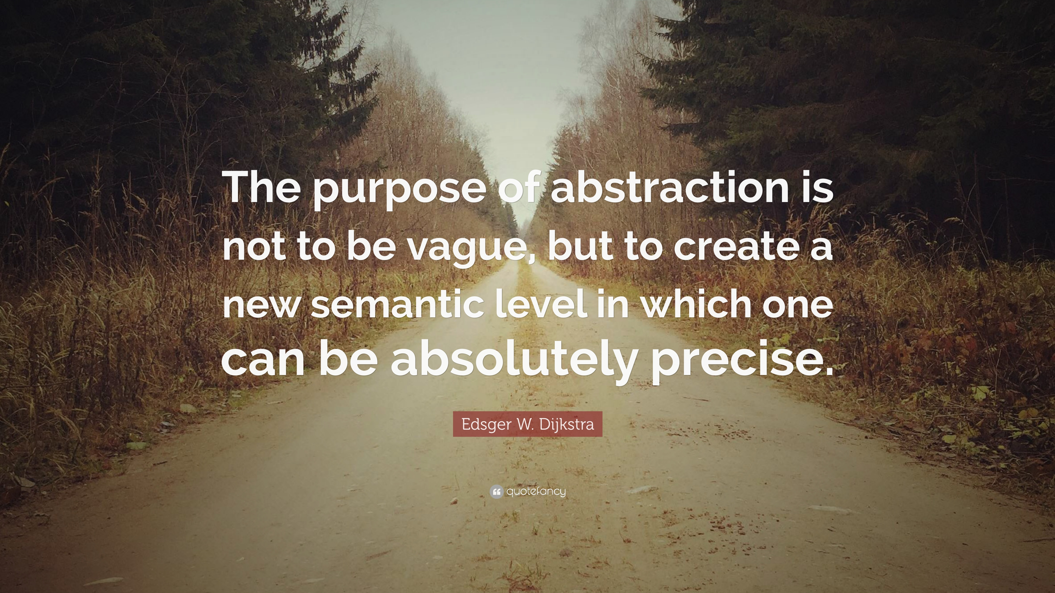
Notes:
Any talk on abstraction needs to include this quote by Dijkstra. Edsger Dijkstra was a pioneer in computer science who won the Turing award in 1972. And I think it’s absolutely hilarious that I could find this image online, with this sepia nature scene, where you would expect some generic quote about life and death, misattributed to Mark Twain. But instead we have Dijkstra talking about abstraction.

Slide 16
It has been suggested that there is some kind of law of nature telling us that the amount of intellectual effort needed grows with the square of program length. But, thank goodness, no one has been able to prove this law. And this is because it need not be true. We all know that the only mental tool by means of which a very finite piece of reasoning can cover a myriad cases is called “abstraction”; as a result the effective exploitation of [their] powers of abstraction must be regarded as one of the most vital activities of a competent programmer. In this connection it might be worth-while to point out that the purpose of abstracting is not to be vague, but to create a new semantic level in which one can be absolutely precise. Of course I have tried to find a fundamental cause that would prevent our abstraction mechanisms from being sufficiently effective. But no matter how hard I tried, I did not find such a cause. As a result I tend to the assumption —up till now not disproved by experience— that by suitable application of our powers of abstraction, the intellectual effort needed to conceive or to understand a program need not grow more than proportional to program length.
Notes:
Now if we look up the quote in context, we find that it’s actually from Dijkstra’s Turing lecture from 1972.

Slide 17
It has been suggested that there is some kind of law of nature telling us that the amount of intellectual effort needed grows with the square of program length. But, thank goodness, no one has been able to prove this law. And this is because it need not be true. We all know that the only mental tool by means of which a very finite piece of reasoning can cover a myriad cases is called “abstraction”; as a result the effective exploitation of [their] powers of abstraction must be regarded as one of the most vital activities of a competent programmer. In this connection it might be worth-while to point out that the purpose of abstracting is not to be vague, but to create a new semantic level in which one can be absolutely precise. Of course I have tried to find a fundamental cause that would prevent our abstraction mechanisms from being sufficiently effective. But no matter how hard I tried, I did not find such a cause. As a result I tend to the assumption —up till now not disproved by experience— that by suitable application of our powers of abstraction, the intellectual effort needed to conceive or to understand a program need not grow more than proportional to program length.
Notes:
And I’d like to read a small part of it.

Slide 18
EXAMPLE
Notes:
That’s all well and good. But let’s take a look at a concrete example.

Slide 19
VECTOR GRAPHICS
Notes:
I sometimes make recursive pictures using vector graphics.

Slide 20
Notes:
And when I do that, I work with these things. This is a vector, or a drawing of a vector.

Slide 21
MAGNITUDE
DIRECTION
Notes:
A vector is something that has a magnitude and a direction.

Slide 22
Y
X
Notes:
If you have a two-dimensional vector, you can decompose it into two dimensions, the x component and the y component.

Slide 23
VECTOR OPERATIONS
Notes:
You can also do things with vectors.

Slide 24
ADDING VECTORS
Notes:
You can for instance add two vectors together.

Slide 25
V₁

Slide 26
V₂
V₁

Slide 27
V₃ = V₁ + V₂
V₂
V₁

Slide 28
SCALING VECTORS

Slide 29
V₁

Slide 30
V₁
V₂ = 2 * V₁

Slide 31
V₁

Slide 32
V₁
V₂ = 0.5 * V₁

Slide 33
GOAL WRITE MY COMPUTER PROGRAM IN TERMS OF VECTOR OPERATIONS

Slide 34
PROBLEM THERE ARE NO VECTORS IN MY COMPUTER

Slide 35
SOLUTION INTRODUCE VECTOR AS AN ABSTRACTION IN MY COMPUTER

Slide 36
GOAL AVOID HAVING TO THINK ABOUT HOW VECTORS ARE REPRESENTED

Slide 37
FIRST ATTEMPT

Slide 38
public class Vector {
public double X { get; set; }
public double Y { get; set; }
}

Slide 39
THIS IS JUST A NAMED STRUCTURE
public class Vector {
public double X { get; set; }
public double Y { get; set; }
}
Notes:
We called it a Vector, but it isn’t a Vector.

Slide 40
VECTORS ARE IMMUTABLE

Slide 41
public class Vector {
public Vector(double x, double y)
{
X = x; Y = y;
}
public double X { get; }
public double Y { get; }
}

Slide 42
MISSING MAGNITUDE AND ANGLE

Slide 43
public class Vector {
public Vector(double x, double y)
{
X = x; Y = y; }
public double X { get; }
public double Y { get; }
public double Magnitude =>
Math.Sqrt(X * X + Y * Y);
public double Angle =>
Math.Atan2(Y, X);
}

Slide 44
MISSING VECTOR OPERATIONS

Slide 45
public class Vector {
// Properties omitted
// Addition public static Vector operator +(Vector v1, Vector v2) =>
new Vector(v1.X + v2.X, v1.Y + v2.Y);
// Scaling
public static Vector operator *(double f, Vector v) =>
new Vector(f * v.X, f * v.Y);
}

Slide 46
COORDINATE-CENTRIC

Slide 47
public class Vector { private Vector(double x, double y)
{
X = x; Y = y; }
// Properties & operators omitted
public static Vector
FromCoordinates(double x, double y)
{
return new Vector(x, y);
} public static Vector FromMagnitudeAndAngle(double m, double a)
{
var x = m * Math.Cos(a);
var y = m * Math.Sin(a);
return new Vector(x, y);
}
}

Slide 48
VALUE EQUALITY

Slide 49
public class Vector {
// Omitted the rest
public bool Equals(Vector other)
{
if (ReferenceEquals(other, null))
return false;
if (ReferenceEquals(this, other))
return true;
double maxDifference = 0.00001;
return X - other.X < maxDifference &&
Y - other.Y < maxDifference;
}
}

Slide 50
REASONABLE VECTORS IN THE MACHINE

Slide 51
WHEN IS A STRUCTURE NAMED VECTOR AN ACTUAL VECTOR ABSTRACTION?

Slide 52
WHEN IT BEHAVES MUCH LIKE A VECTOR

Slide 53
ARE VECTORS EVEN USEFUL?
Notes:
I sometimes make recursive pictures using vector graphics.

Slide 54
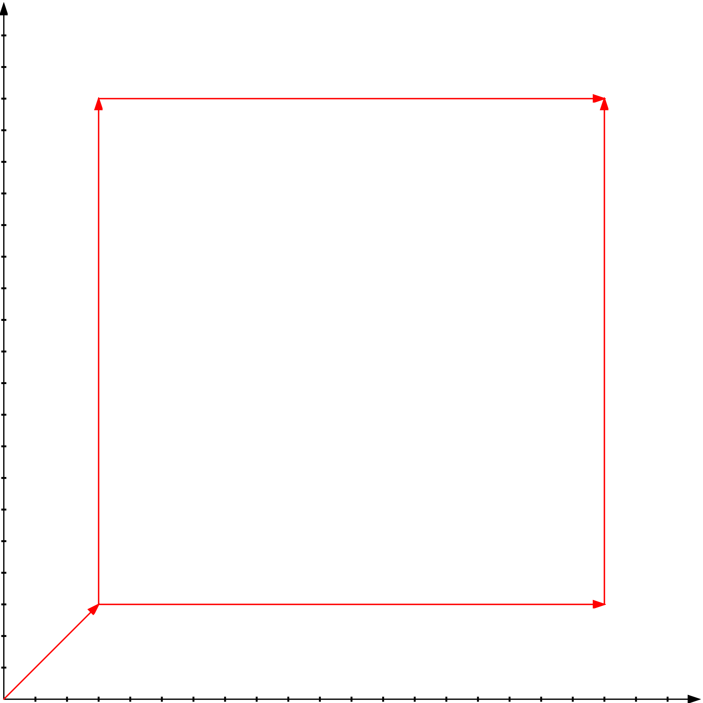

Slide 55
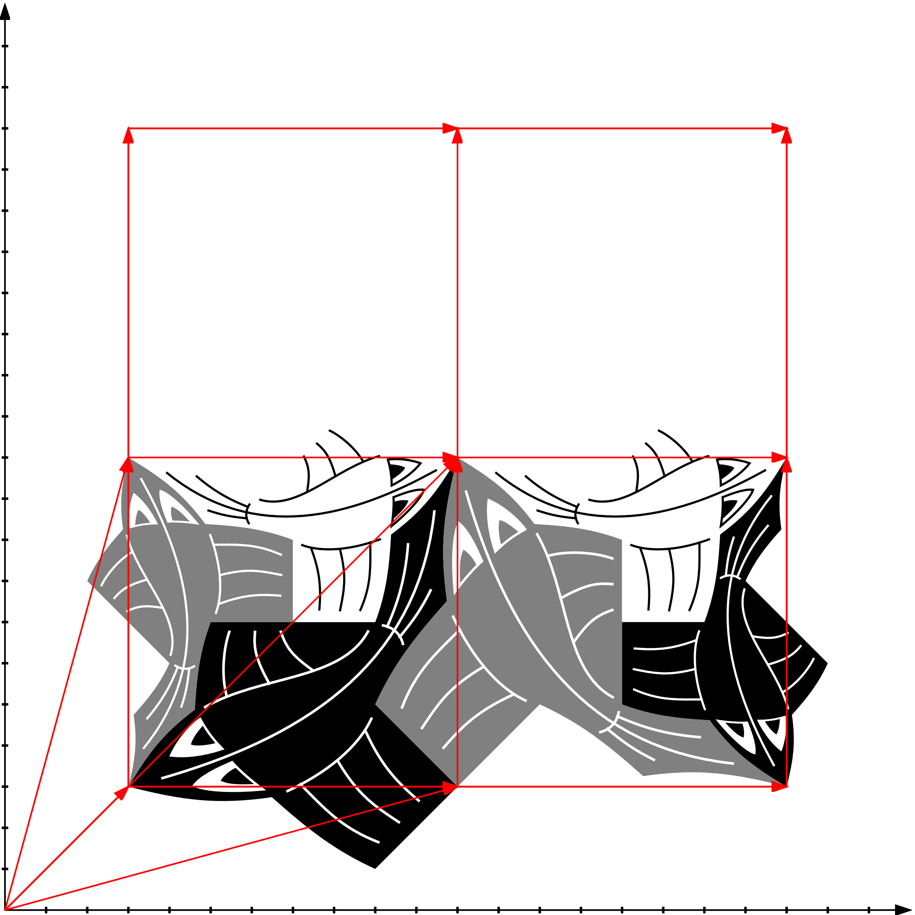

Slide 56
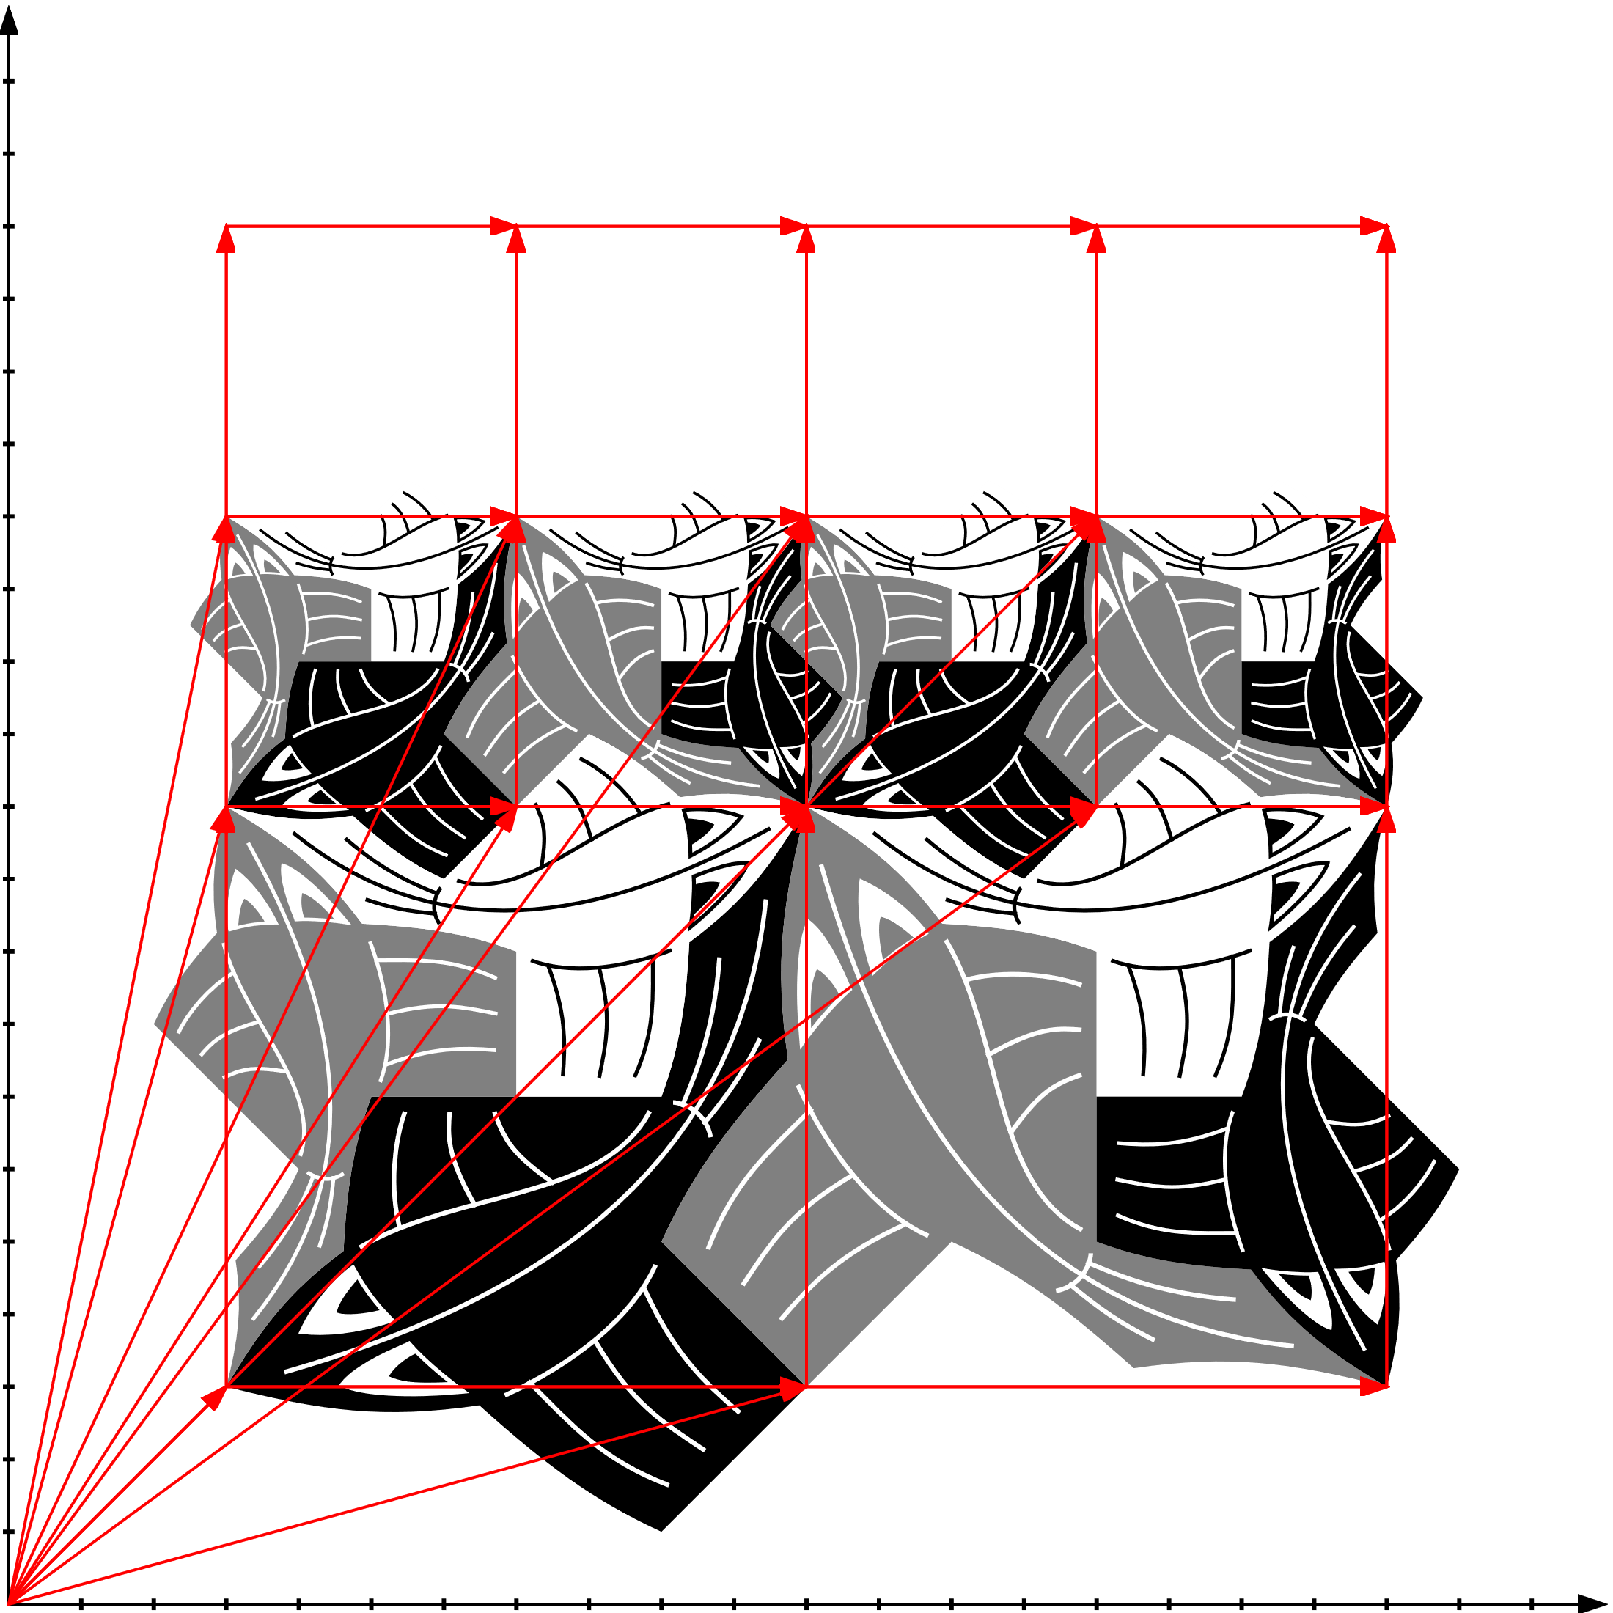

Slide 57
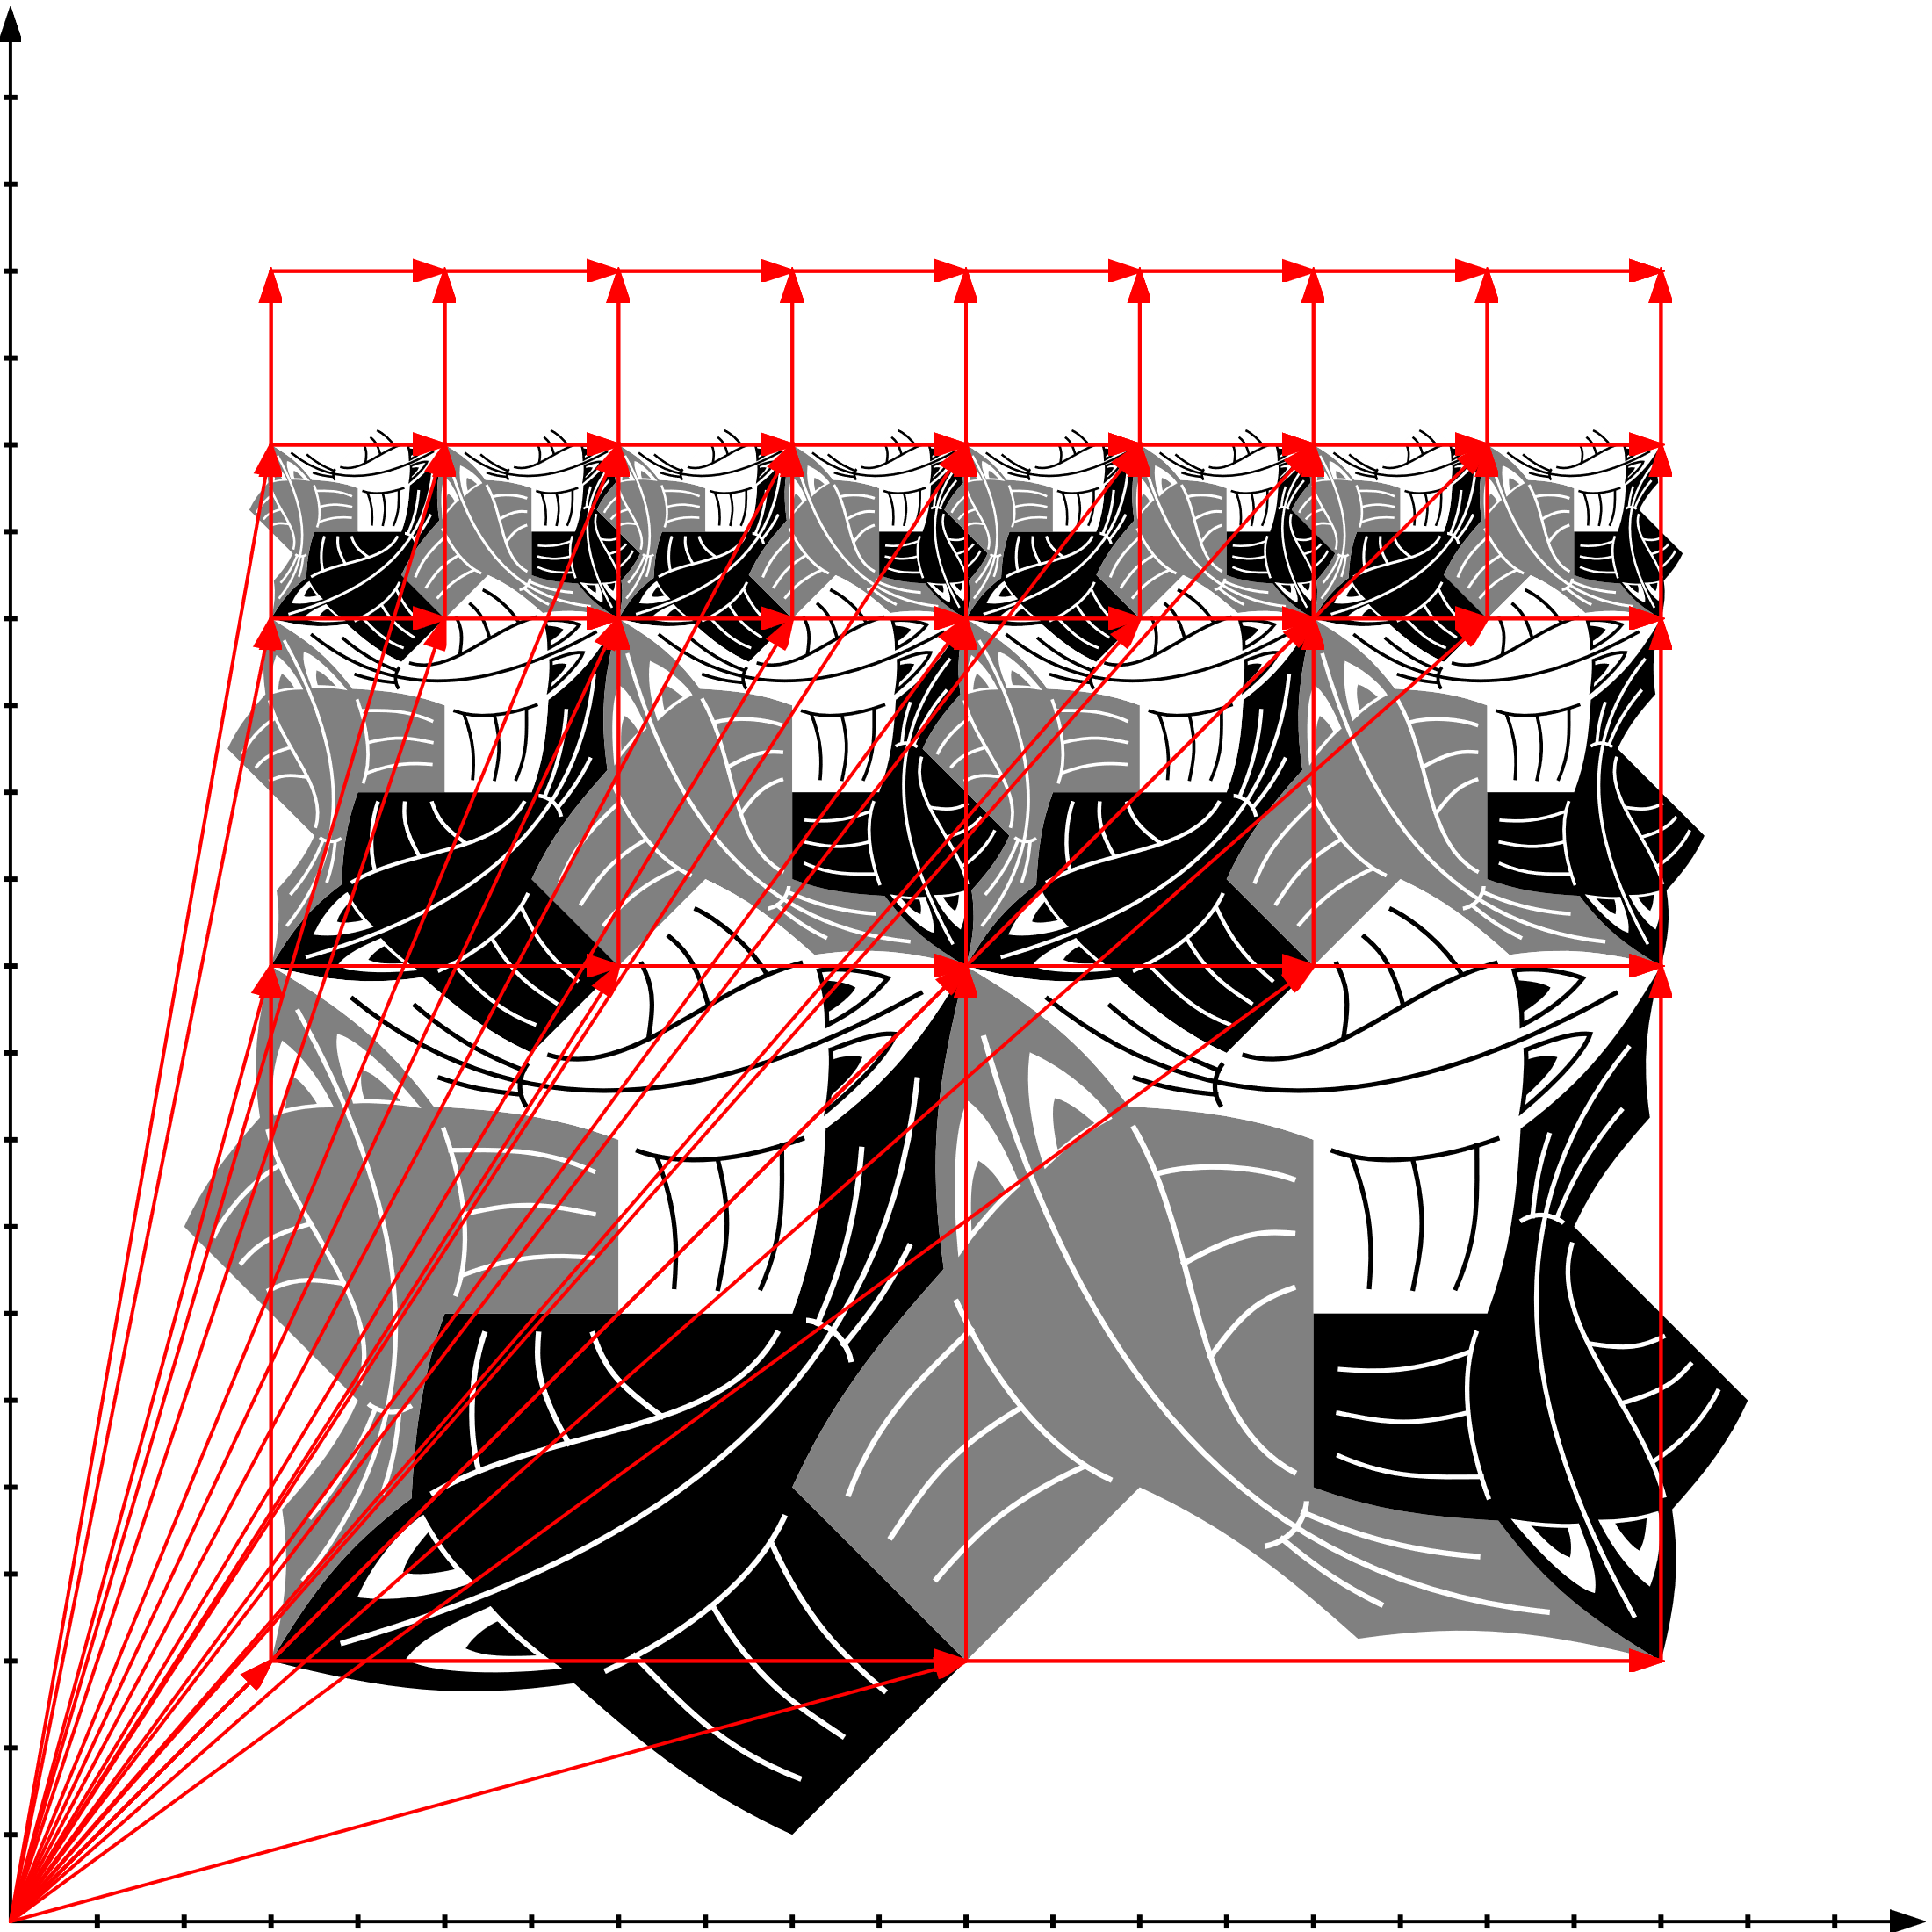

Slide 58
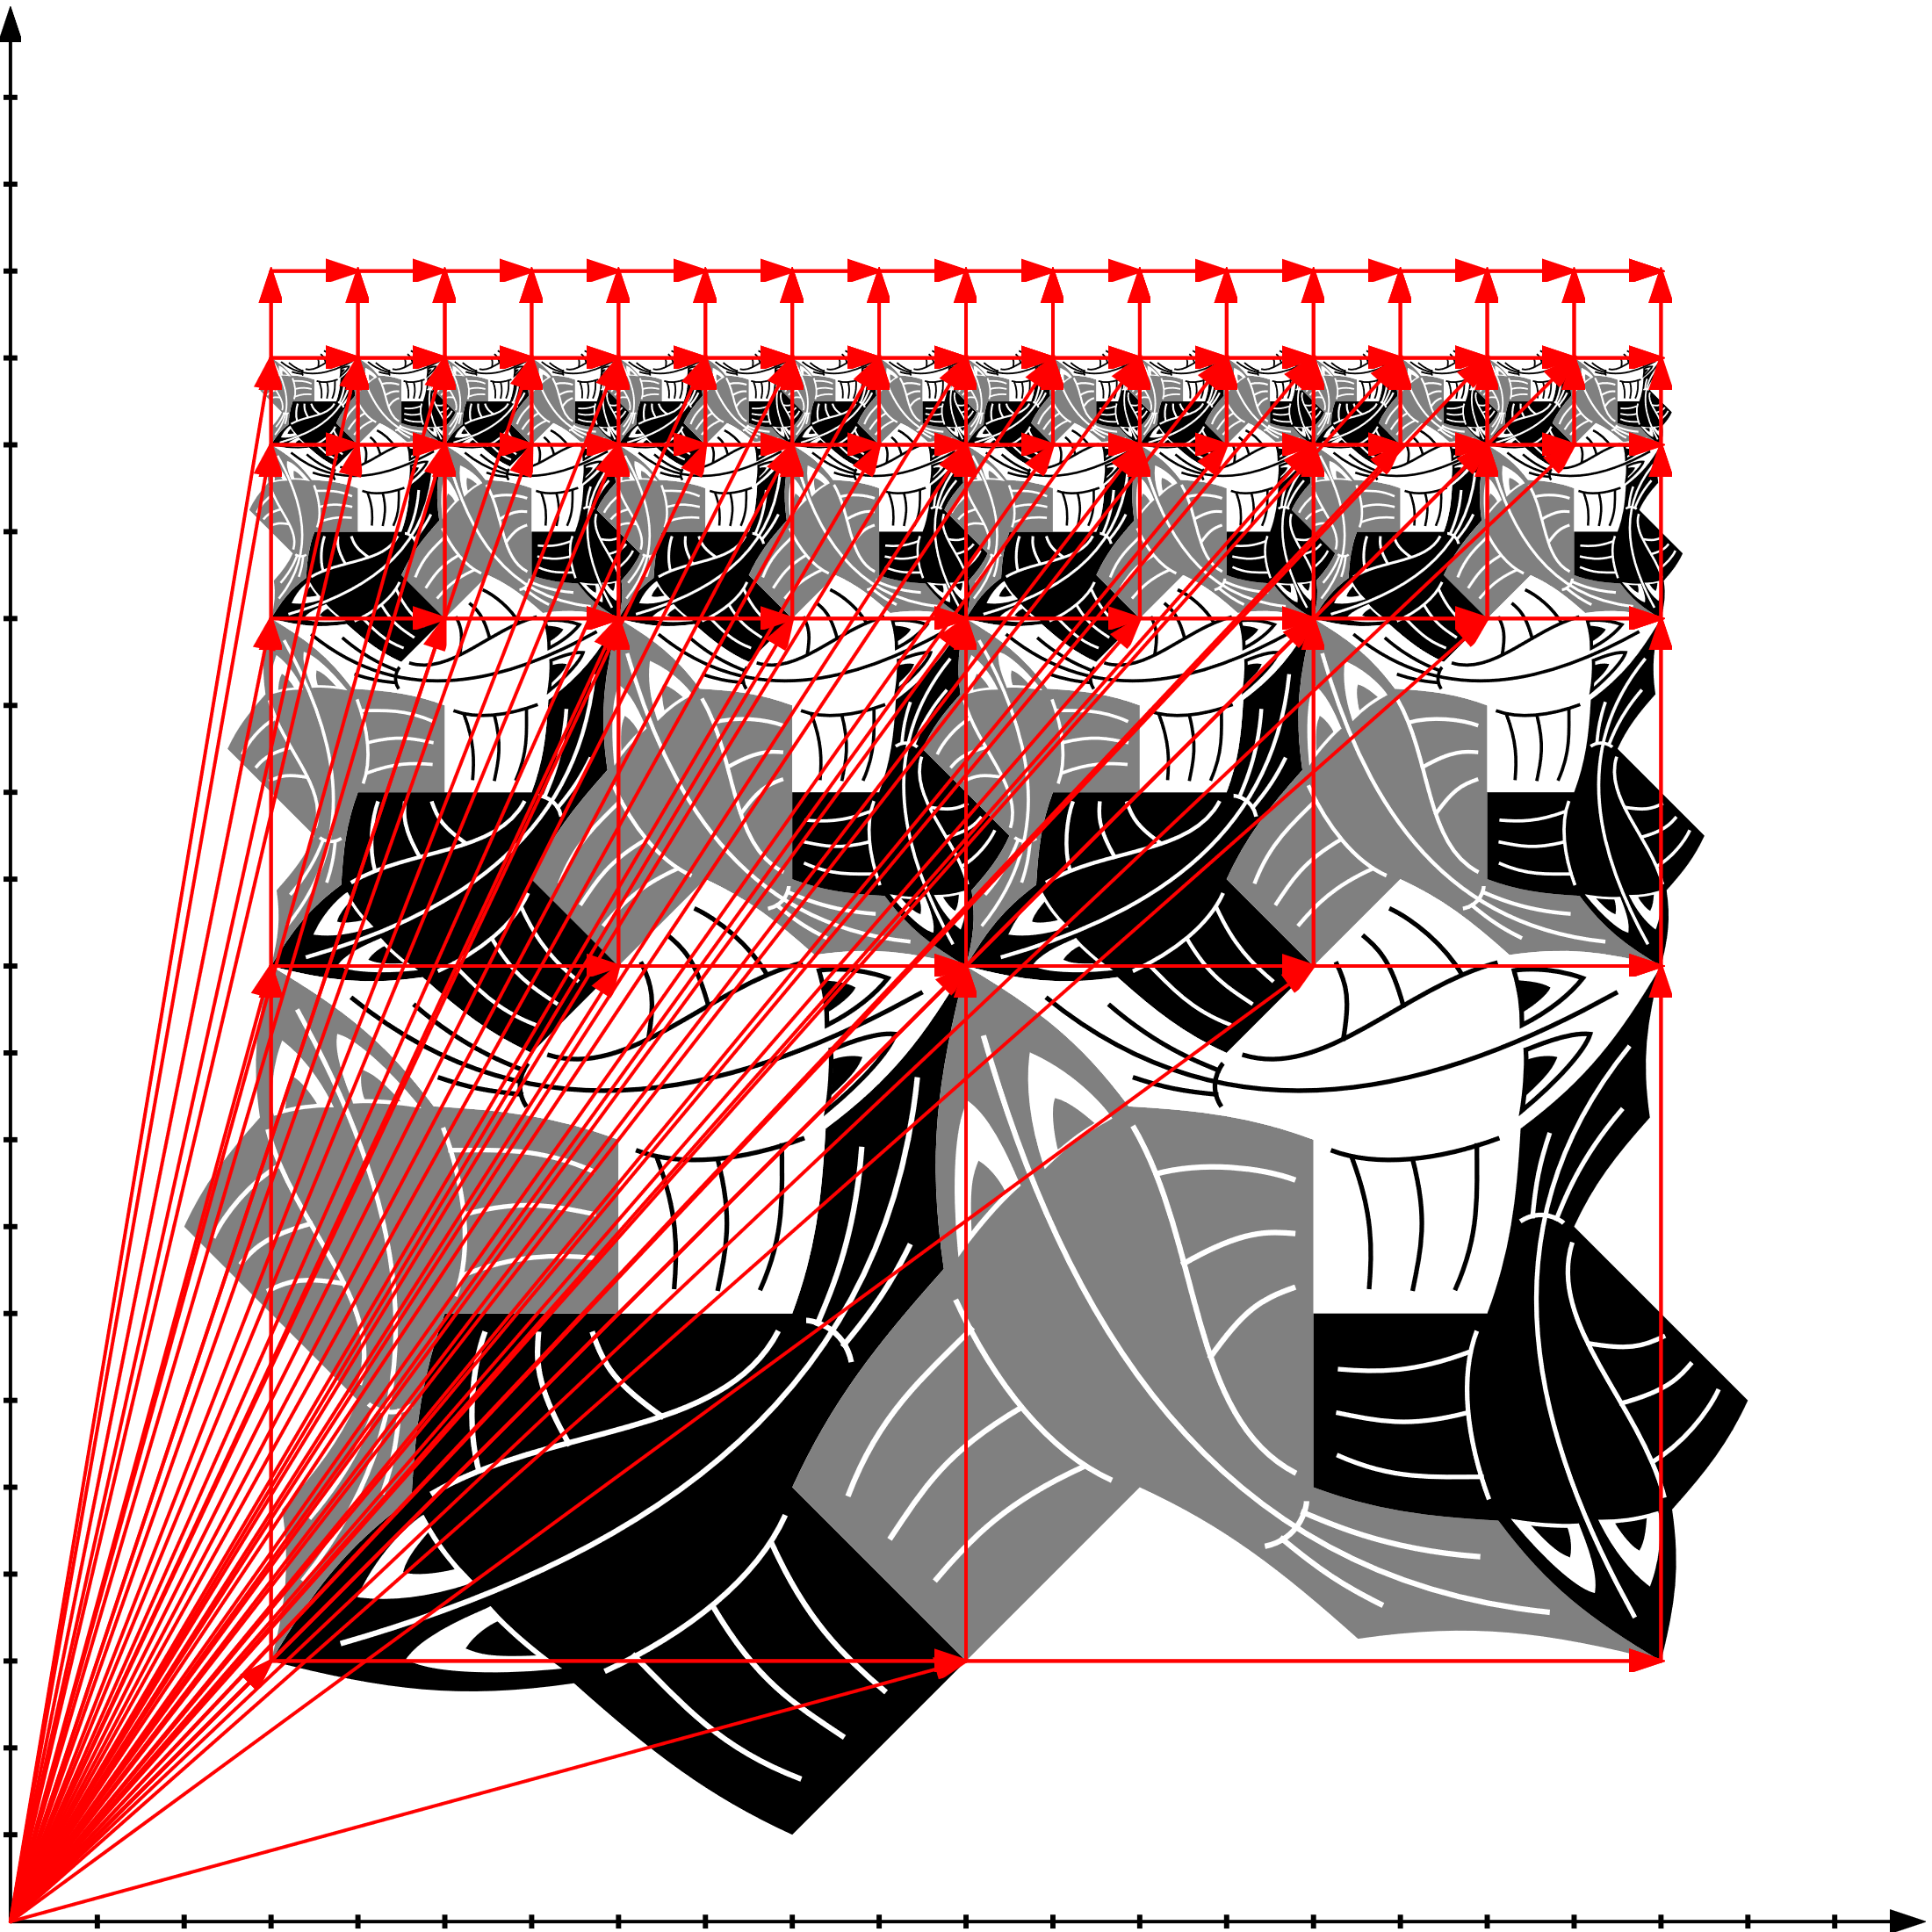

Slide 59
